Slide 1
Artificial Intelligence Chapter 2: Problem Solving in AI

Slide 2
Index
General introduction
Problem space
Problem formulation
Examples of problem formulation
Solving problems by searching
Informed and Uninformed searching
Measuring performances of search techniques
Uninformed searching techniques
BFS, UCS, DFS, DLS, IDDFS, BIDIRECTIONAL

Slide 3
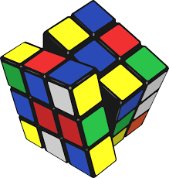
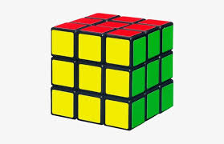

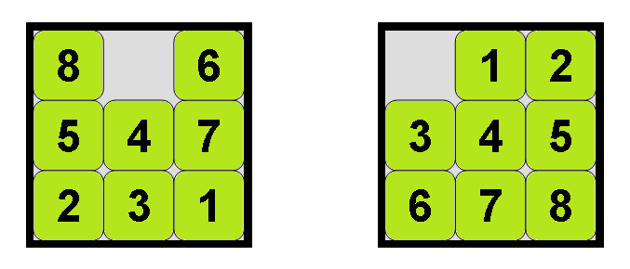
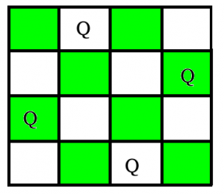

General introduction….
Classes of problems
Toy problems
Real world problems
Robot navigation
Route finding problem
VLSI design problem
Automatic assembly sequencing

Slide 4
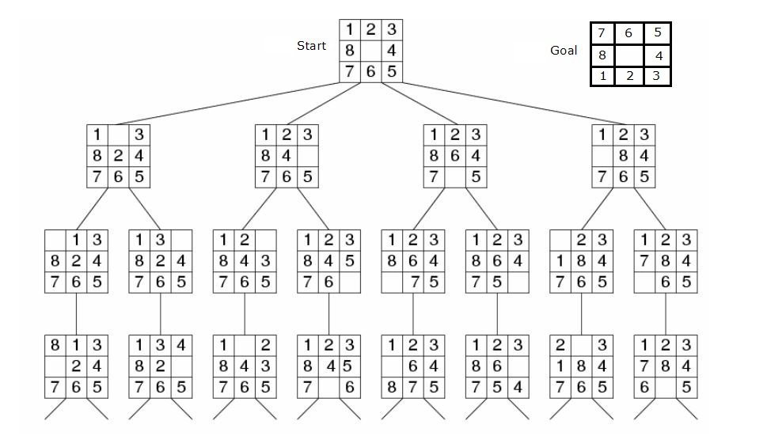
Solving problems

Slide 5
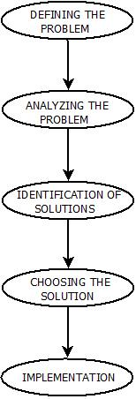
Problem space
Problems are the issues which comes across any system. A solution is needed to solve that particular problem.
Some computation is required to find out the set of possible paths and also some computation is required to find out the best possible path among the available path that will lead us to goal.
In general we can classify the problem solving process in following steps:

Slide 6
Problem solving process
1. Defining The Problem: The definition of the problem must be included precisely. It should contain the possible initial as well as final situations which should result in acceptable solution.
2. Analyzing The Problem: Analyzing the problem and its requirement must be done as few features can have immense impact on the resulting solution.
3. Identification Of Solutions: This phase generates reasonable amount of solutions to the given problem in a particular range.
4. Choosing a Solution: From all the identified solutions, the best solution is chosen basis on the results produced by respective solutions.
5. Implementation: After choosing the best solution, its implementation is done.

Slide 7
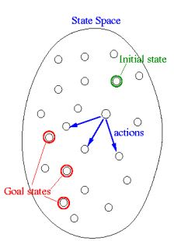
Problem formulation
Problem formulation is a process of deciding what States to be considered and what actions to be taken to achieve the goal this is the first day to be taken by any problem solving agent.
State space: The state space of a problem is the set of all states reachable from initial state by executing any sequence of actions. State is representation of all possible outcomes.

Slide 8
Problem formulation
Problem can be defined formally using these components as follows:
1. Initial state: initial state is the one in which agent starts in.
2. Actions/Operators: It is the set of actions that can be executed or applicable in all possible states.
3. Successor function: It is the function that returns a state on executing an action on the current state.
4. Goal test: It is a test to determine whether the current state is a goal state in some problems by comparing current state with defined goal state.
5. Path cost: It is simply a cost associated with each step to be taken to reach to the goal state. to determine the cost to reach each state there is a cost function which is chosen by problem solving agent.

Slide 9
Problem formulation
We are now ready to formally describe a search problem. A search problem consists of the following:
A search problem is represented by a 4-tuple {S, s₀, A, G}
S: the full set of states
s₀ : the initial state
A:S→S is a set of operators/actions
G is the set of final states. Note that G ⊆S

Slide 10
Example 1: 8-puzzle problem
States: state can be represented by 3 by 3 matrix data structure. There are 8 tiles and one vacant position with blank denoted by 0. State specifies the position of all 8 tiles and position of 1 vacant tile.
1. Initial state: In this, you can consider any state as initial state from which you start the game. {{1,2,3},{4,8,0},{7,6,5}}
2. Actions: the blank space can move in left, right, up & down direction specifying the actions
3. Successor function: if we apply down operator to start the state in figure the resulting state has the five and the blank witched. {{1,2,3}, {4,8,5}, {7,6,0}}
4. Goal test: this is a function that verifies that whether the current state is goal state or not. {{1,2,3},{4,5,6},{7,8,0}}
5. Path cost: Each move of the blank costs 1
Solution: {{1,2,3}, {4,8,0}, {7,6,5}} → {{1,2,3}, {4,8,5}, {7,6,0}} → {{1,2,3}, {4,8,5}, {7,0,6}} → {{1,2,3}, {4,0,5}, {7,8,6}} → {{1,2,3}, {4,5,0}, {7,8,6}} → {{1,2,3}, {4,5,6}, {7,8,0}}
Path cost = 5

Slide 11
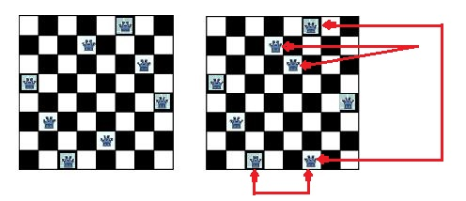
Example 2: 8-queen problem
The problem is to place 8 queens on a chessboard so that no two queens are in the same row, column or diagonal.
The picture below on the left shows a solution (goal state) of the 8-queens problem. The picture on the right is not a correct solution, because some of the queens are attacking each other.

Slide 12
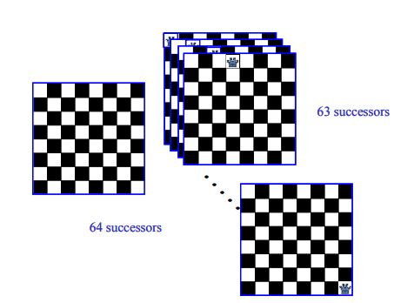
8-queens problem formulation 1
States: Any arrangement of 0 to 8 queens on the board
Initial state: 0 queens on the board
Successor function: Add a queen in any square
Goal test: 8 queens on the board, none are attacked

Slide 13
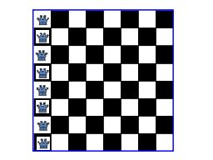
8-queens problem formulation 2
States: Any arrangement of 8 queens on the board
Initial state: All queens are at column 1
Successor function: Change the position of any one queen
Goal test: 8 queens on the board, none are attacked
If we consider moving the queen at column 1,
it may move to any of the seven remaining columns.

Slide 14
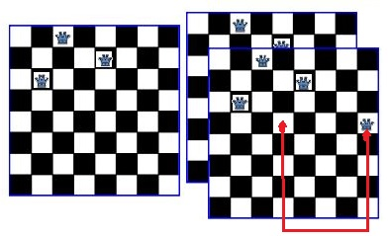
8-queens problem formulation 3
States: Any arrangement of k queens in the first k rows such that none are attacked
Initial state: 0 queens on the board
Successor function: Add a queen to the (k+1)th row so that none are attacked.
Goal test : 8 queens on the board, none are attacked

Slide 15
Example 4: Missionaries & cannibals problem
States: in this problem state can be a data structure having triplet (i,j,k) presenting the number of Missionaries, cannibals and canoes on the left Bank of the river respectively.
Initial state: it is (3,3,1) all missionary's cannibals and canoes on the left Bank of the river
Actions: take X number of missionary's and Y number of cannibals
Successor function: if we take one missionary and one cannibal the other side of river will have two missionary's and two cannibals on the left
Goal test: reached state (0,0,0)
Path cost: number of Crossings to attain the goal state

Slide 16
Example 5: Real time problem
Airline travel problem : Agent organising your travelling plan he will arrange the travelling plan for your holiday so that you will visit all places with minimum cost and should spend less time in travelling from one location to another we can now formulate the problem.

Slide 17
Example 5: Real time problem
States: state is represented by airport location and current date and time in order to calculate the path cost. State may also record more information about previous segments of flights, their fare bases and their status as a domestic or International.
Initial state: The location from which you are starting the journey is initial state
Actions: Your travel arrangement from one location to another that facilitate you journey
Successor function: After taking the action i.e. selecting flight, location, date, time; what is the next location date and time reached is denoted by the successor function
Goal test: The destination location of your journey
Path cost: In this case, path cost is cost of travelling (fare, travel time)

Slide 18
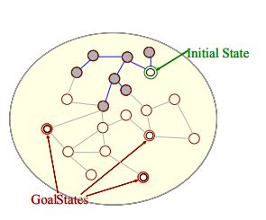
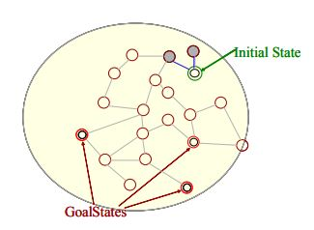
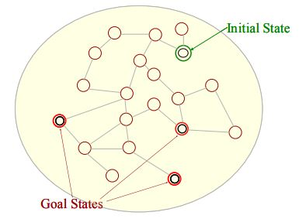
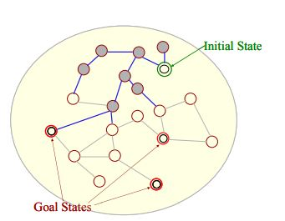
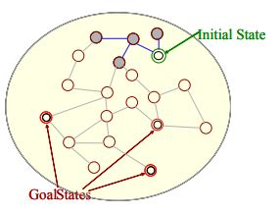
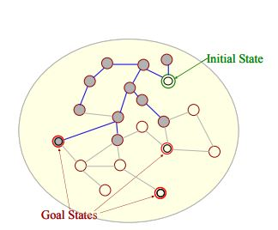
Searching process
Do until a solution is found or the state space is exhausted.
1. Check the current state
2. Execute allowable actions to find the successor states.
3. Pick one of the new states.
4. Check if the new state is a solution state. If it is not, the new state becomes the current state and the process is repeated

Slide 19
Solving problems by searching
Search algorithm can be used to find the path in state space.
It is possible that a path can take us to an undesirable state or at a dead end. A search algorithm therefore should be efficient enough to govern the agent towards the desirable state.
Rational agents in AI mostly used these search strategies or algorithms to solve a specific problem and provide the best result. In this topic, we will learn various problem solving search algorithms
Search strategies or algorithms can be classified into two categories:
Uninformed search(Blind)
Informed search(Heuristic)

Slide 20
Informed search (heuristic search)
Informed search is a problem specific search. These algorithms use domain knowledge.
The search strategy depends on the information available for a specific search problem.
Heuristic function is used to find the path that can lead to the goal state. This function can judge the available path by ranking them.
There is a high probability that the path selected by heuristic function will lead us to goal but not guaranteed. Not always be guaranteed for best solutions but guaranteed to find a good solution in reasonable time
Informed search strategies can find a solution more efficiently than an uninformed search strategy. Informed search is also called a Heuristic search
Informed search can solve much complex problem which could not be solved in another way.
It can be divided into these types:
Best First (Greedy) Search
A* Search
AO* search
Local search

Slide 21
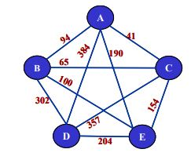
Travelling salesman problem
Travelling salesman problem is a special touring problem(route finding problem) where we have ;
Given a set of cities and distance between every pair of cities, the problem is to find the shortest possible route that visits every city exactly once and returns to the starting point.

Slide 22
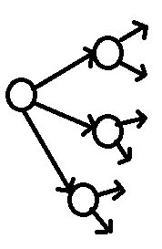
Uninformed search (blind search)
Uninformed search is not dependent on the problem specific information for its search strategy. It does not contain any domain knowledge.
This kind of search strategy does not use selective approach while generating states. It operates in a brute-force way. It generates all possible states and explores most of them to find the goal state, so it is also called blind search.
It operates in a brute-force way as it only includes information about how to traverse the tree and how to identify leaf and goal nodes
This approach requires more time to explore entire state space.
It can be divided into various types:
Breadth-first search
Uniform cost search
Depth-first search
Depth limited search
Iterative deepening depth-first search
Bidirectional Search

Slide 23
Measuring performance of search algorithms
The efficiency of all these algorithms can be evaluated on the basis of following factors.
Completeness: A search algorithm is said to be complete if it guarantees to return a solution if at least any solution exists for any random input.
Optimality: If a solution found for an algorithm is guaranteed to be the best solution (lowest path cost) among all other solutions, then such a solution for is said to be an optimal solution.
Time Complexity: Time complexity is a measure of time for an algorithm to complete its task. It depends on the time taken to generate the solution. It is the number of nodes generated during the search
Space Complexity: It is the maximum storage space required at any point during the search, as the complexity of the problem.

Slide 24
Breadth First Search(BFS): Uninformed
Breadth-first search is the most common search strategy for traversing a tree or graph. This algorithm searches breadth wise in a tree or graph, so it is called breadth-first search.
BFS algorithm starts searching from the root node of the tree and expands all successor node at the current level before moving to nodes of next level i.e. the nodes are expanded level wise
The strategy of breadth-first search algorithm is it expands the shallowest node first.
Breadth-first search implemented using FIFO queue data structure.

Slide 25
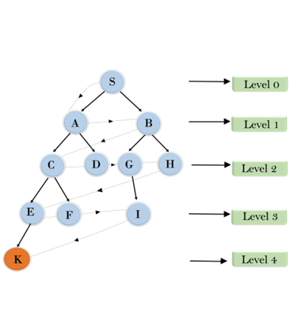











Breadth First Search(BFS): Uninformed
Output
D
F I
K
S
G
H
E
A
B
C

Slide 26
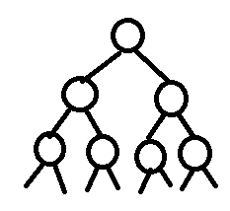
Breadth First Search(BFS): Uninformed
BFS is complete, which means if the shallowest goal node is at some finite depth, then BFS will find a solution.
BFS is optimal if path cost is a non-decreasing function of the depth of the node. It finds solution with shortest path length.
Exponential time & space complexities, O (b^{d}). where d is depth of the solution and b is branching factor (i.e. no of children factor) at each node
Example: Suppose each node have 2 children i.e. b=2 and goal node is at depth d=3. So we denote in O (b^{d}) like,
2 to the power 3 i.e. O (2³)= 8

Slide 27
Uniform Cost Search: Uninformed
Uniform-cost search is a searching algorithm used for traversing a weighted tree or graph.
This algorithm comes into play when a different cost is available for each edge.
The primary goal of the uniform-cost search is to find a path to the goal node which has the lowest cumulative cost.
Uniform-cost search expands nodes according to their path costs form the root node. It can be used to solve any graph/tree where the optimal cost is in demand.
A uniform-cost search algorithm is implemented by the priority queue. It gives maximum priority to the lowest cumulative cost.
Uniform cost search is equivalent to BFS algorithm if the path cost of all edges is the same.

Slide 28
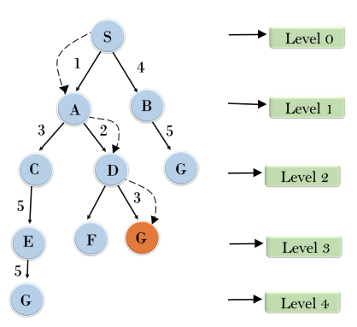
Uniform Cost Search: Uninformed

Slide 29
Uniform Cost Search: Uninformed
Uniform-cost search is complete, such as if there is a solution, UCS will find it.
Uniform-cost search is always optimal as it only selects a path with the lowest path cost.
Time complexity of Uniform-cost search is O(b^{d}).
Space Complexity of Uniform-cost search is O(b^{d}).

Slide 30
Depth First Search(DFS): Uninformed
Depth-first search is a recursive algorithm for traversing a tree or graph data structure
It is called the depth-first search because it starts from the root node and follows each path to its greatest depth node before moving to the next path.
The strategy of depth-first search algorithm is it expands the deepest node first.
DFS uses a stack data structure for its implementation.
The process of the DFS algorithm is similar to the BFS algorithm.

Slide 31
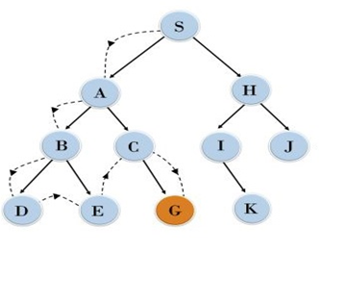








Depth First Search(DFS): Uninformed
Output
S
A
B
D
E
C
G

Slide 32
Depth First Search(DFS): Uninformed
Not complete, DFS search algorithm is complete within finite state space as it will expand every node within a limited search tree
DFS search algorithm is non-optimal, as it may generate a large number of steps or high cost to reach to the goal node.
Exponential time O (b^{d}), but only linear space
Space complexity of DFS is equivalent to the size of the fringe set(stack), which is O(bm).
where, m= maximum depth of any node

Slide 33
Depth limited Search: Uninformed
A depth-limited search algorithm is similar to depth-first search with a predetermined limit.
Depth-limited search can solve the drawback of the infinite path in the Depth-first search.
In this algorithm, the node at the depth limit will treat as it has no successor nodes further.
We can think of depth first search as a special case of depth-limited search where depth limit l = infinite

Slide 34
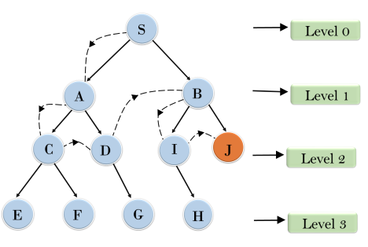
Depth limited Search: Uninformed
Depth limit l = 2

Slide 35
Depth limited Search: Uninformed
DLS search algorithm is complete if the solution is above the depth-limit.
Depth-limited search can be viewed as a special case of DFS, and it is also not optimal even if ℓ>d.
Time complexity of DLS algorithm is O(b^{ℓ}).
Space complexity of DLS algorithm is O(b×ℓ).

Slide 36
Iterative deepening depth first search: Uninformed
The iterative deepening algorithm is a combination of DFS and BFS algorithms.
This search algorithm finds out the best depth limit and does it by gradually increasing the limit until a goal is found.
This algorithm performs depth-first search up to a certain "depth limit", and it keeps increasing the depth limit after each iteration until the goal node is found.
This Search algorithm combines the benefits of Breadth-first search's fast search and depth-first search's memory efficiency.
The iterative search algorithm is useful uninformed search when search space is large, and depth of goal node is unknown.

Slide 37
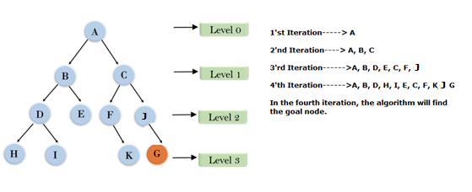
Iterative deepening depth first search: Uninformed

Slide 38
Iterative deepening depth first search: Uninformed
This algorithm is complete is if the branching factor is finite.
IDDFS algorithm is optimal if path cost is a non- decreasing function of the depth of the node.
Let's suppose b is the branching factor and depth is d then the worst-case time complexity is O(b^{d}).
The space complexity of IDDFS will be O(bd).

Slide 39
Bidirectional Search: Uninformed
Bidirectional search algorithm runs two simultaneous searches, one form initial state called as forward-search and other from goal node called as backward-search, to find the goal node.
Bidirectional search replaces one single search graph with two small sub graphs in which one starts the search from an initial vertex and other starts from goal vertex.
The search stops when these two graphs intersect each other.
Bidirectional search can use search techniques such as BFS, DFS, DLS, etc.
The fact that b^{d/2} + b^{d/2} is less than b^{d}, encourages us to adopt this strategy in many scenarios.

Slide 40
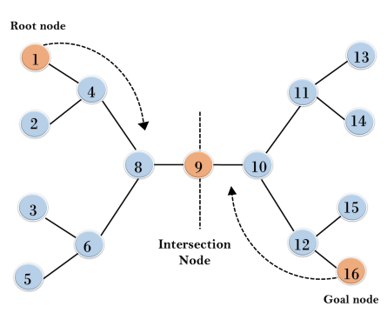
Bidirectional Search: Uninformed

Slide 41
Bidirectional Search: Uninformed
Bidirectional Search is complete if we use BFS in both searches.
Bidirectional search is Optimal.
Time complexity of bidirectional search using BFS is O(b^{d}).
Space complexity of bidirectional search is O(b^{d}).

Slide 42
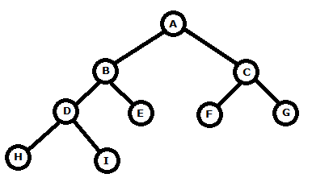
Examples:
Calculate traversing path using BFS, DFS(G is goal),DLS(l=2) and IDDFS(initially l=0)

Slide 43
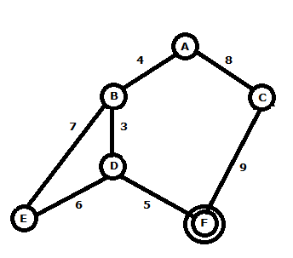
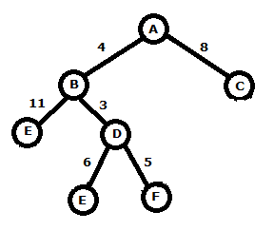
Examples:
Calculate traversing path using Uniform cost search
Search tree

